Slide 2
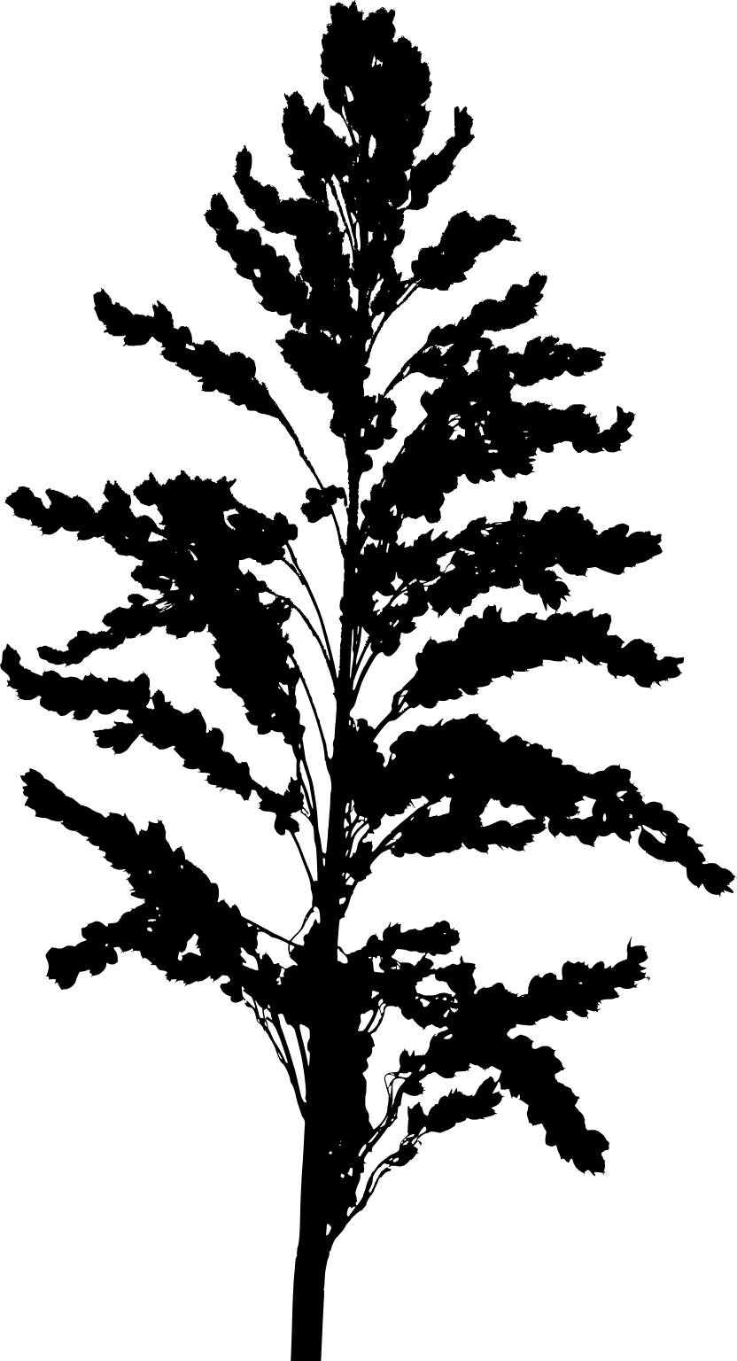
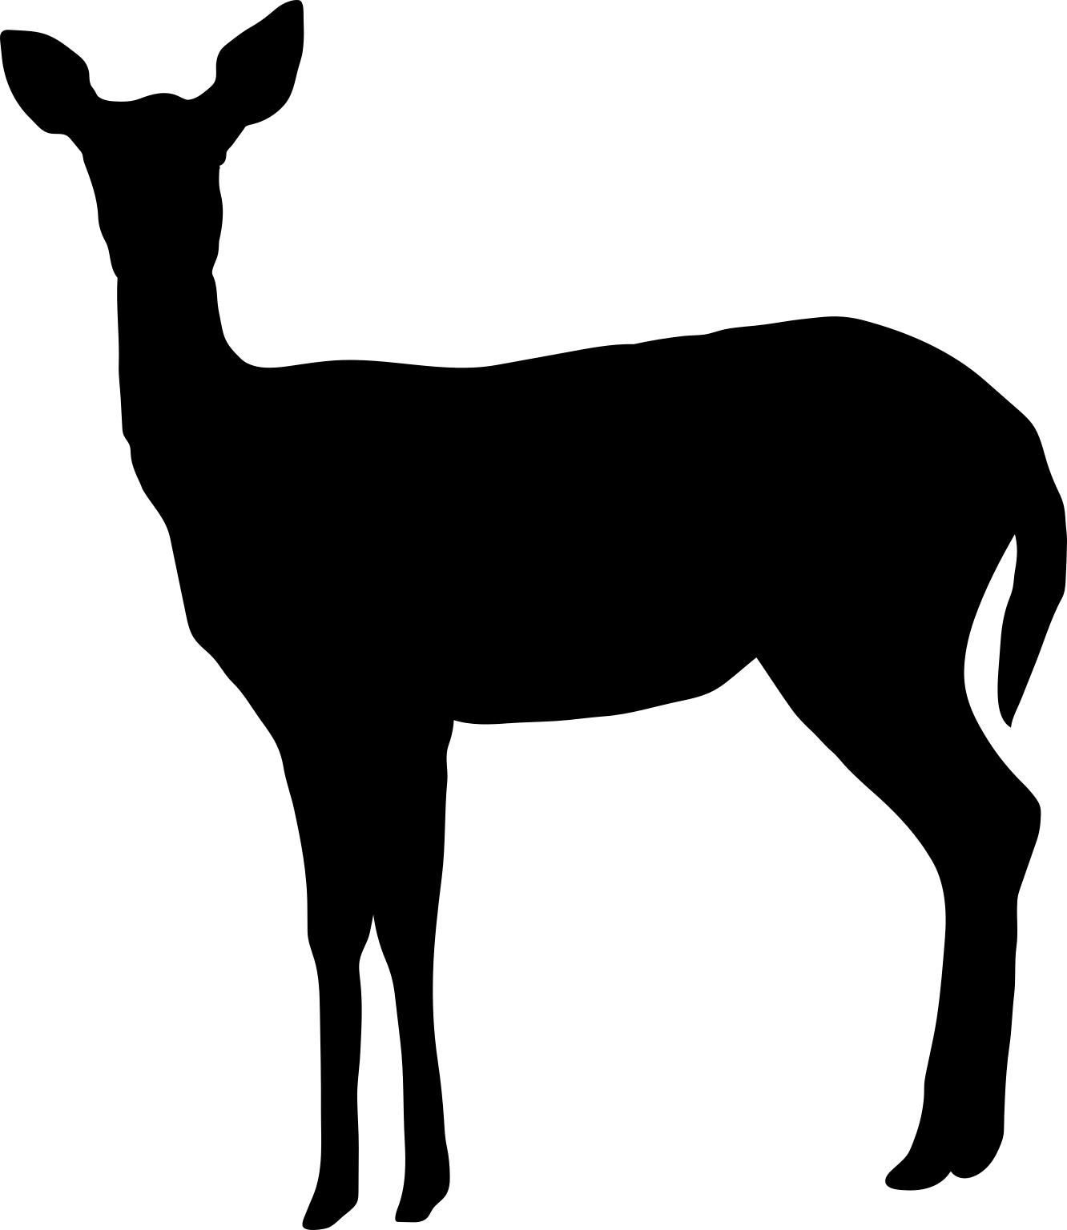



Responses I want to look at
Some measure of adult female detections
Some measure of adult female detections with fawns
Things I care about
Some measure of landscape disturbance for each site
Some measure of weather variables representing winter harshness in T-1at each site
Some sort of interaction between the two potentially
Things I don’t care about and just want to control for
Some measure of predator activity at each site
Some measure of habitat characteristics or productivity at each site
Hierarchical effects of landscape unit and year (boring ole variance)

Slide 3
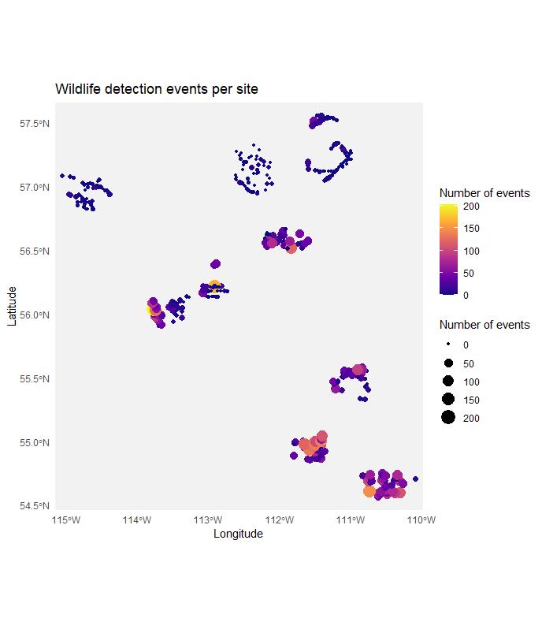
Summary
430 sites from 2021-2024
97,620 images of WTD
8,619 independent detections (30 mins)
327 /430 sites ( 76% occupancy)
10/10 arrays (100 % occupancy)
Somewhat of a south-north gradient

Slide 4
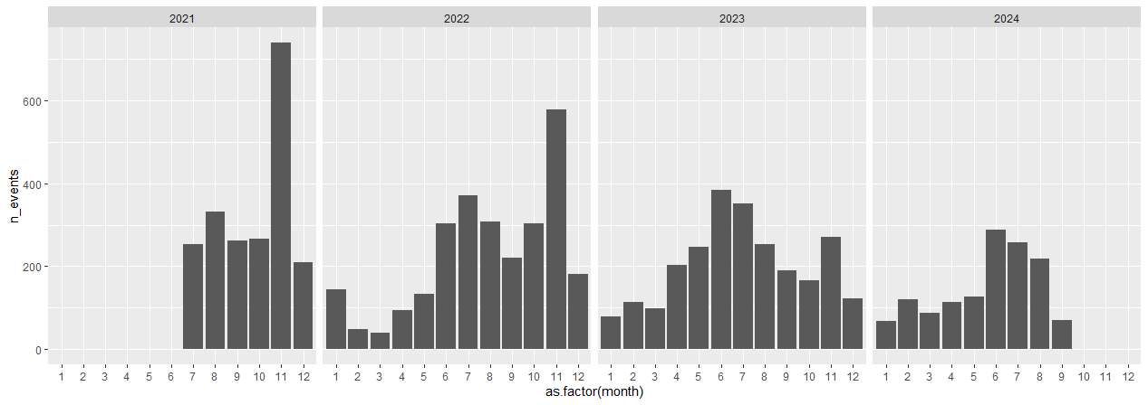
Time series looks kind of how you would expect, more detections in summer, less in winter

Slide 5
Breaking this down to events of just females vs females with young of year
2418 independent detections
289/430 sites (67%)
10/10 arrays (100%)
956 independent detections
149/430 sites (35%)
10/10 arrays (100%)

Slide 6
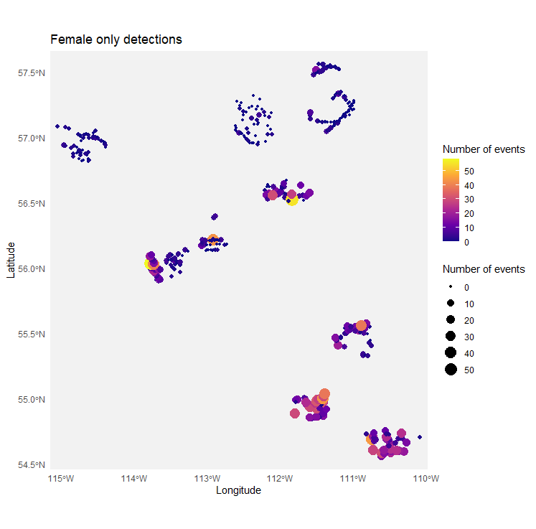
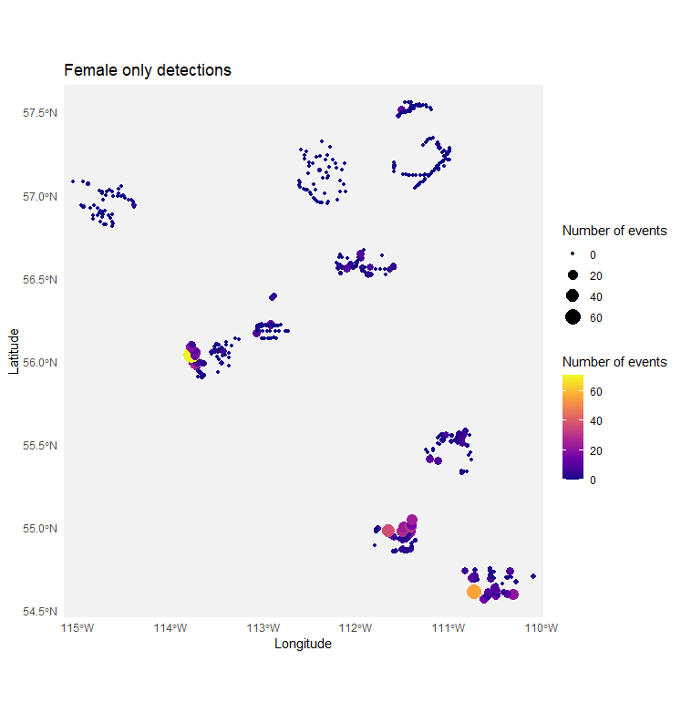

Slide 7
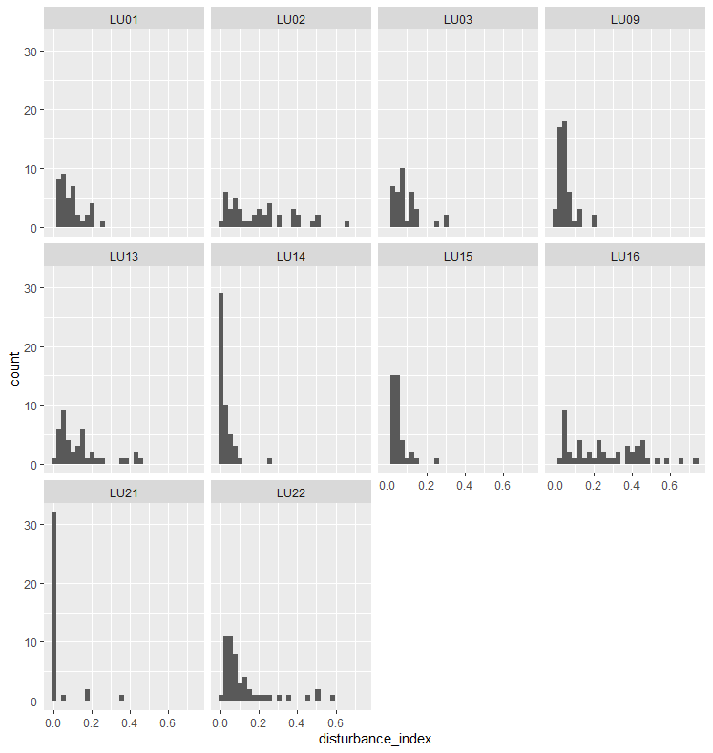
Disturbance sum

Slide 8
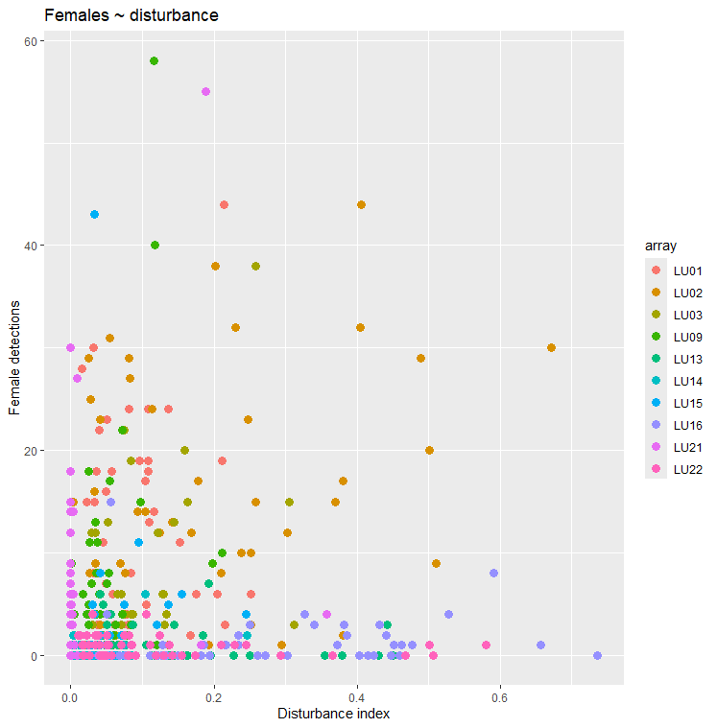
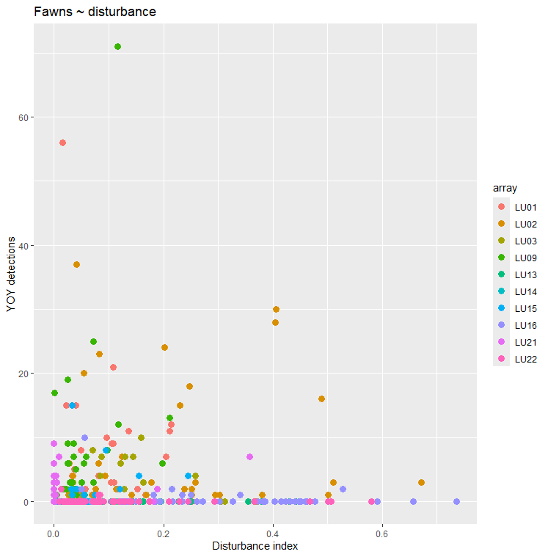

Slide 9
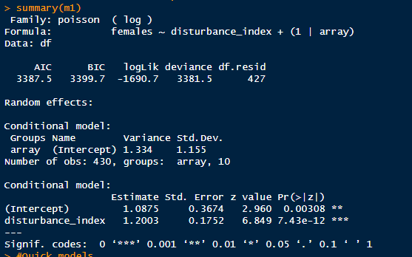
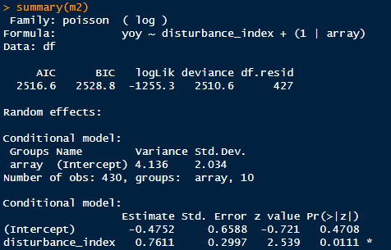
Positive effect of disturbance on both groups
Stronger for females → lone females like more disturbance
Weaker for fawns → females with fawns like higher disturbance but not as much
More variation in landscape unit for fawns
Simple model structure though. Potential limit of disturbance for fawns? Considering a quadratic or breakpoint

Slide 10
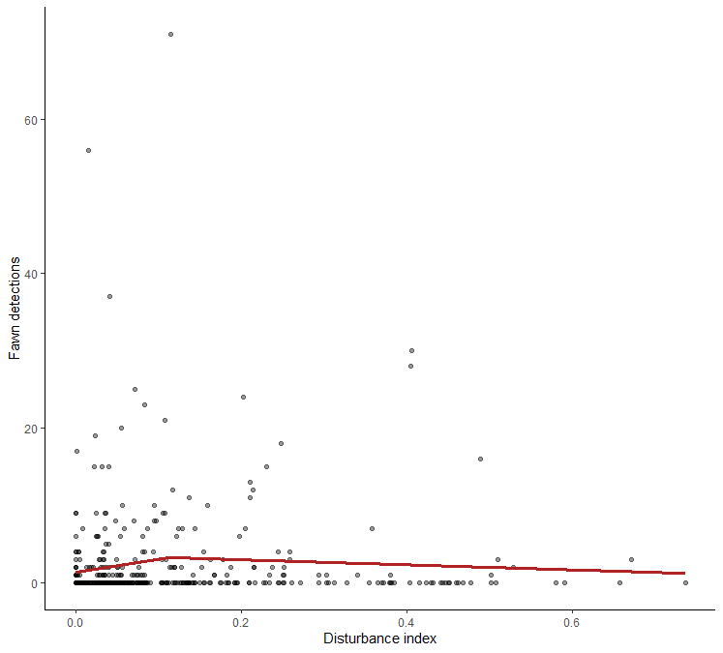
Segmented analysis looks like crap

Slide 11
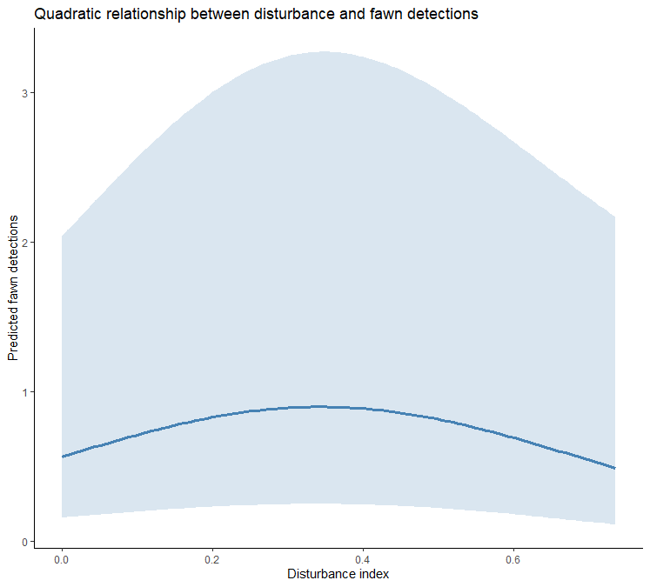
Quadratic not much better

